Slide 1
CO₂ storage though Enhanced Oil Recovery Process

Slide 2
Contents
Introduction
System Design/Definition
Exergy analysis
Exergy of CO₂ Capture And Storage
Exergy analysis of CO₂ EOR
Conclusion

Slide 3
Introduction
The concentration of carbon dioxide in the atmosphere is increasing. It is one of the most undesired gases in the atmosphere as it increases global warming and hence, the global temperature.
Carbon dioxide content increases due to the combustion of fossil fuels for a multitude of processes, essentially energy production and other large number of reasons.
Burning fossil fuels for energy production is cheap yet inefficient. Still, due to its availability, we started exploiting it to the extent that they are now about to exhaust.
The Enhanced Oil Recovery (EOR) process not only uses carbon dioxide and hence reduces its content, but it also increases the lifetime of the oil fields while enhancing the rate of oil recovery.

Slide 4
System Design/Definition
Through this study, we wish to analyze the current Enhanced Oil Recovery process and comment on its storage sustainability. For this, we have considered a basic system that focuses on the main processes and looks into the overall scheme. Large pipes running over long distances carry the produced carbon dioxide to the field site in compressed form. There it is again compressed before final injection into the oil-producing sites where it expands and pushes the oil out while some part of it is stored inside.

Slide 5
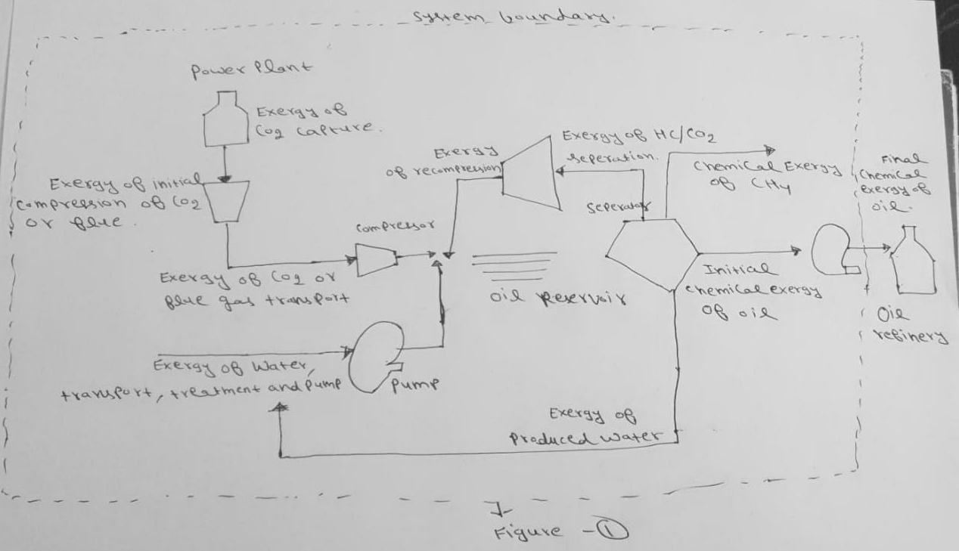
System definition including Exergy streams

Slide 6
Exergy streams:-
Material stream
Work stream
Material streams:
The chemical energy of crude oil depends only on its composition.
Chemical exergy = Lower heating value(LHV)
LHV = 55.5-14.4(specific gravity)
Gas released from oil is CH4
Neglect the exergy of CO2 and water.

Slide 7
Work stream
Exergy of CO2 capture:-
It is the average exergy value required for separating CO2 from flue gas in the chemical absorption of CO2.
Exergy of CO2 transport, compression and injection:-
Compressors are assumed as isentropic hence S2=S1 and S3=S4
Entropy and Enthalpy can be calculated by using cantera.
We specified some initial criterias.

Slide 8
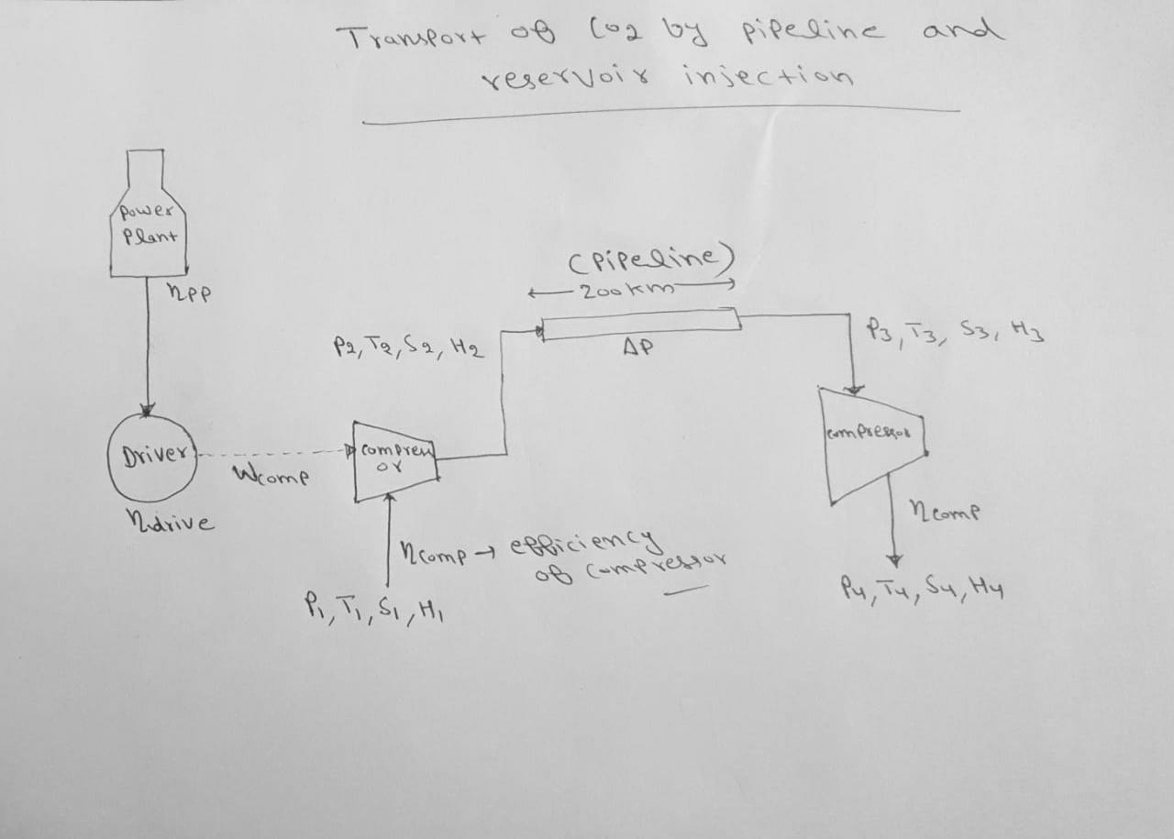
Exergy of CO2 transport, compression and injection

Slide 9
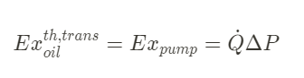
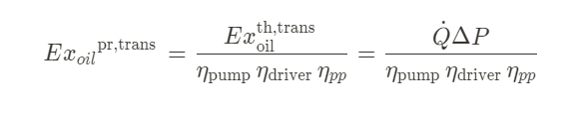
Exergy of CO2 transport, compression and injection:-
Where Q dot stands for the flow rate of the crude oil through the pipeline and Delta P is the pressure drop in the pipeline.
For practical pumping exergy, we will assume certain efficiencies hence the equation will become:-
The separation of the gases from the liquid oil is assumed to take place in a gravity separator vessel; therefore, there is no need to spend exergy in this step.

Slide 10
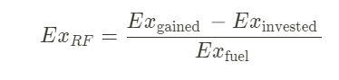
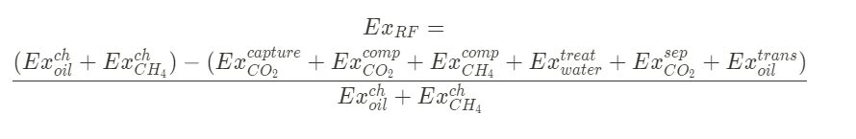
Exergy recovery factor:-
It is defined as
Here,
Gained exergy is the exergy of the final product (within the selected boundary).
Invested exergy is the amount of exergy invested in producing hydrocarbons. And ,
Fuel exergy is the amount of exergy stored in the hydrocarbon reservoir.
If we put every term in recovery factor then we get,

Slide 11
Exergy of CO₂ Capture And Storage.
Goal: To examine the sustainability of standalone CCS process.
Storing 1 kg of CO₂ in CCS produces additional CO₂.
The amount of this CO₂ produced depends on the fossil fuel( methane, oil, coal) that was used to power the storage process.
This CO₂ must also be stored through CCS, which would produce additional CO₂.
Thus find the net amount of CO₂ produced for storing 1 kg of CO₂ that was already existent in the atmosphere.
We find that for Coal, the amount of CO₂ produced in the storing process exceeds the amount that was stored (1 kg).
This shows that the standalone CCS is not sustainable for coal.

Slide 12
Exergy analysis of CO₂ EOR
In this section, the whole process is divided into three parts(such as called Scenario).
Our main aim to provide analysis on the exergy-recovery factor for the carbon dioxide enhanced oil recovery(EOR) process and how CO₂ is utilized by oil recovery theoretically.
While along with the time, the exergy recovery factor decreases, the need of more exergy is raised as the time increases.
Apart from this, gross CO₂ utilization factor is also coming into the picture now because exergy recovery factor is basically function of exergy recovery rate.
The amount of exergy released in a certain process depends on what is happening with the molecules in the process. Due to this happening with molecules, a gases like CO₂ is being released. And to capture this emission of CO₂ , CO₂-Enhanced oil recovery method is used.

Slide 13
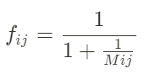
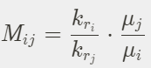
Oil Recovery Factor
Developed by LW Lake and MP walsh.
CO_2 is injected with water to displace oil in a 1-D Porous Medium
Fractional Flow Functions:

Slide 14
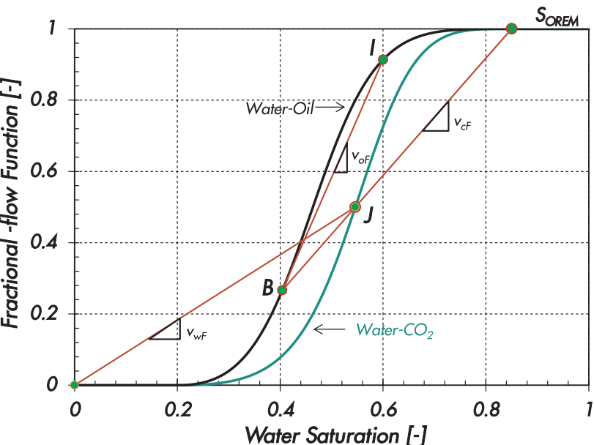
Oil Recovery Factor

Slide 15
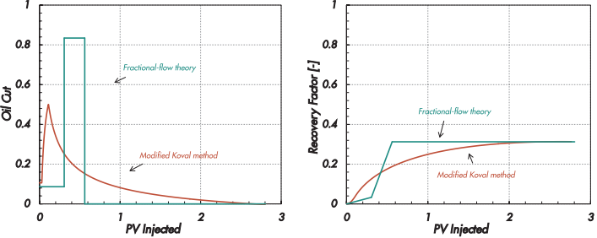
Oil Recovery Factor

Slide 16
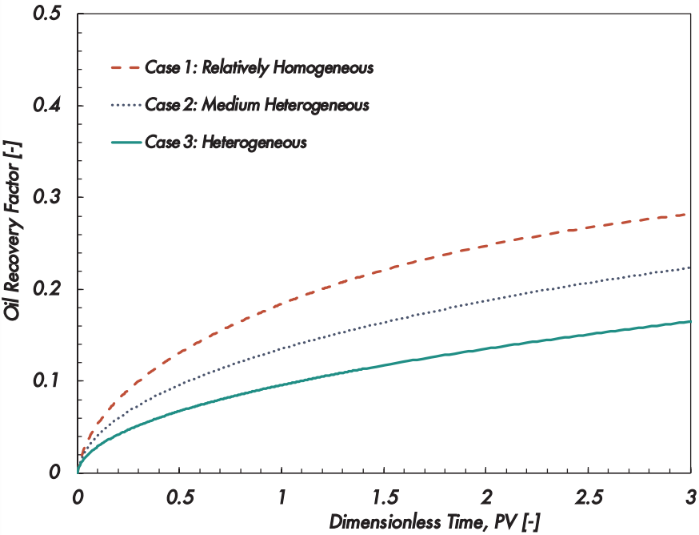
Oil Recovery Factor

Slide 17
Conclusion
We can assess CO_2 EOR using Exergy concept.
Exergy recovery factor decreases with time.
The EOR with CCS is unsustainable.
Reduction in exergy consumption of CO_2 separation
Usage of low carbon source of energy for powering the separation.
If that is done, we can store 400 kg of extra CO_2 per barrel of oil produced.

Slide 18

Thank you!
Team Anuj Ujjval Buch Ashutosh Goyal Ekansh Somani Hritik Ladia Kush Patel

